Slide 1

Smart PLANT Pot
Automatic Plant Monitoring and Irrigation System

Slide 2

pls pretend I have a finished prototype…

Slide 3

problem
Plant owners of all experience often bury more plants than they can keep
Often not available to take care of a plant
Many people buy plants they don’t know much about
Lack of knowledge and experience makes many hesitant to take care of plants with more needs
Prospective owners hesitant to buy due to these reasons

Slide 4
Idea
monitors environment and moisture
Convenient
Features
Use for any plant
Gardens, pots, greenhouses, even weeds!

Slide 5
scope
Wanted to make a system that monitored the environment
Soil moisture
Temperature
Humidity
Light %
Soil pH
Etc…

Slide 6
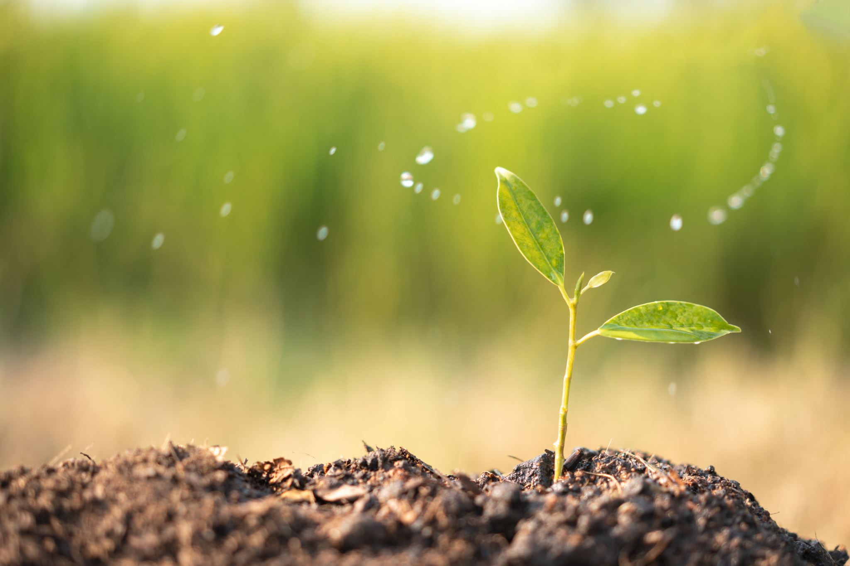

scope
Other features can also be attached such as:
Watering
Changing temp
Indicating plant “happiness”
An app for user interaction
Web interface
Wifi & Bluetooth capability

Slide 7
scope
So many ideas, features, and potential!
I’m just one guy with no experience
Had to make do with little time and only half the parts

Slide 8
Design
This is gonna be so much fun!!!

Slide 9
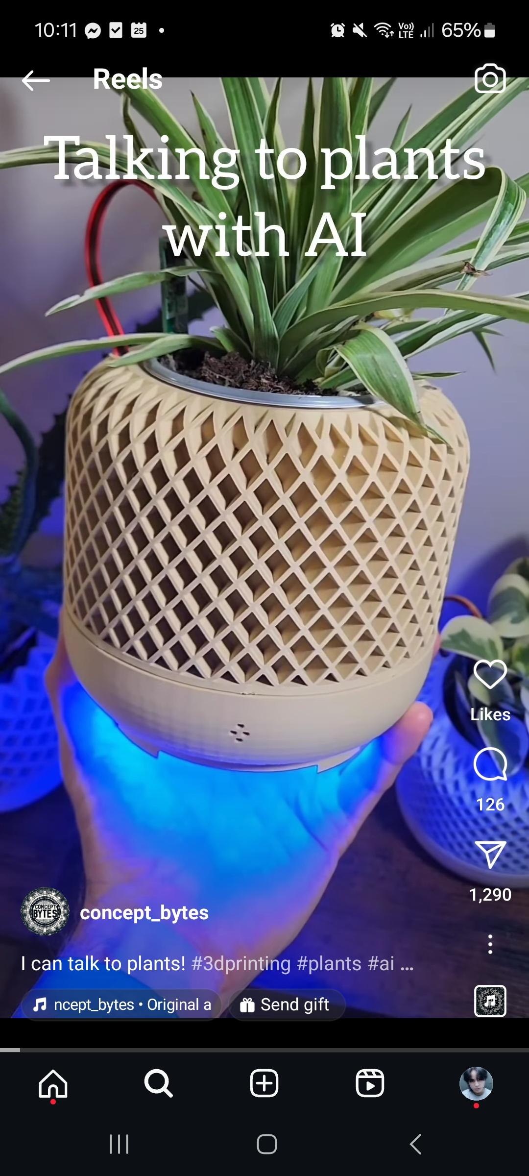
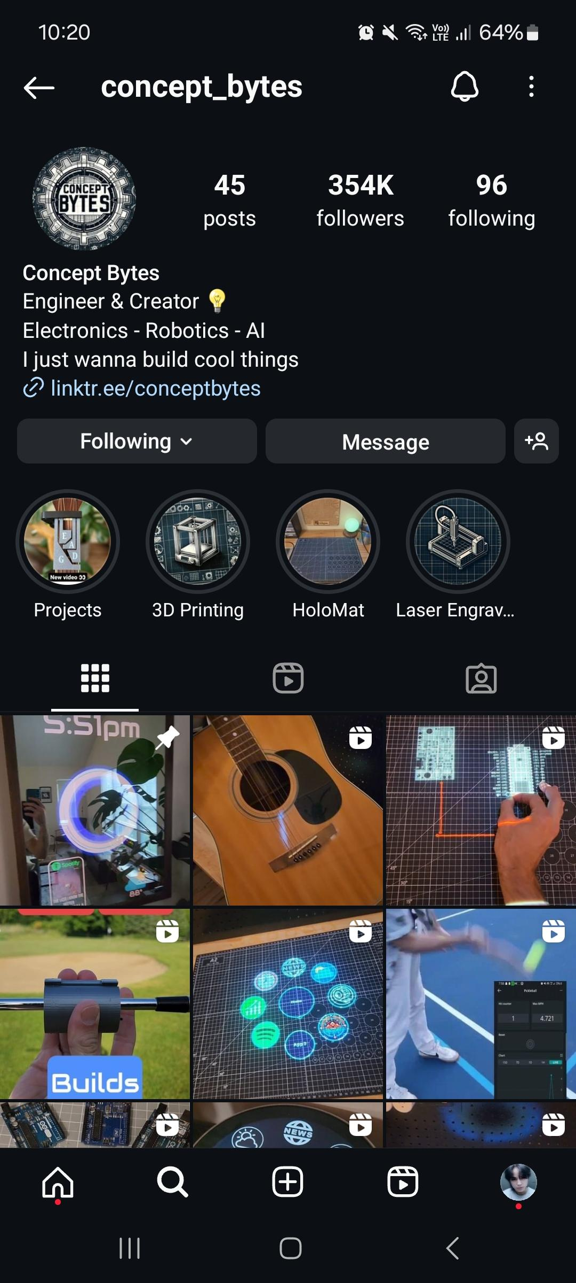
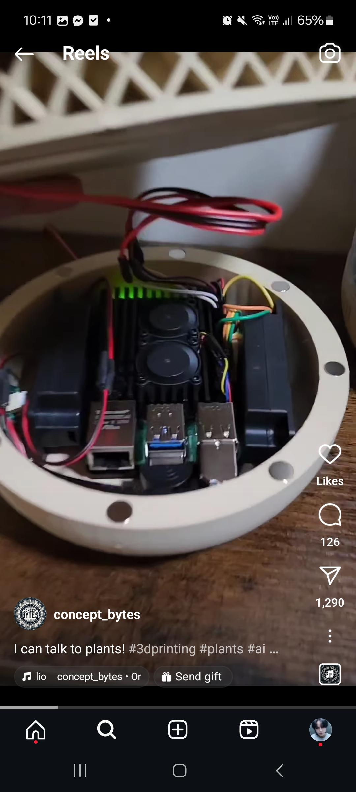
inspiration
Inspired by content creator and engineer @concept_bytes
Many sources online for implementing the basics

Slide 10
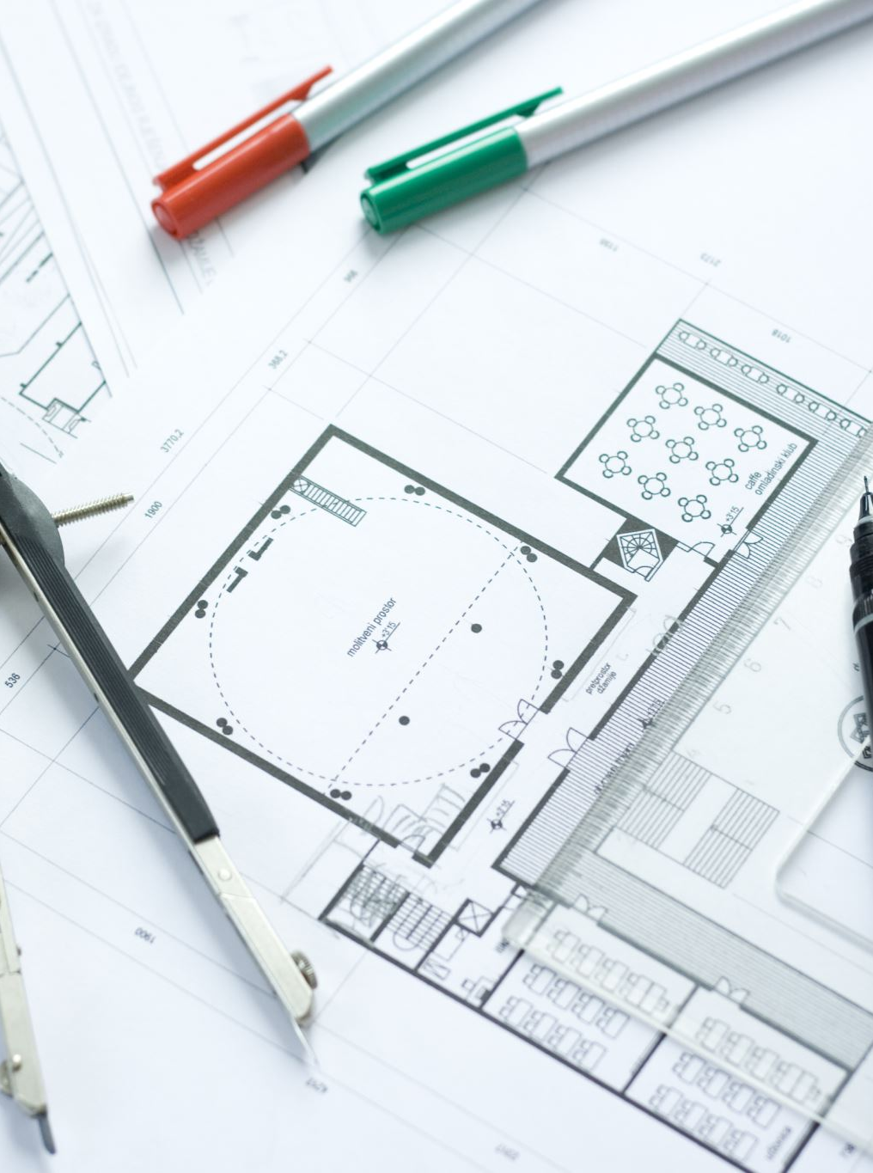
Design plan
The project needs to be significant
Real-world application to make it “big picture”
Sensors, components, design, everything!
Design it all

Slide 11

proposal
Soil sensor, water pump, LED strip, temp/humidity sensor, and LCD screen
Screen displays moisture info, errors, changes, and actions
When soil is too dry, dispense water using pump from a tank
Use a water level sensor to detect when tank is low
A web app to get plant info from the user and more
A Wi-Fi module for more capabilities - surely it won’t take long! ☺

Slide 12
Design process
Please give me access to the workshop

Slide 13
Hardware list
- LED strip
Nano
Water pump
Water level sensor
Soil moisture sensor
Temp & humidity sensor (DHT11)
12V Power supply
Power socket adaptor
Relay
More resistors
Transistor
Soldering board
More wires
Shift register
PLA for 3D Printing
Buttons
And more

Slide 14
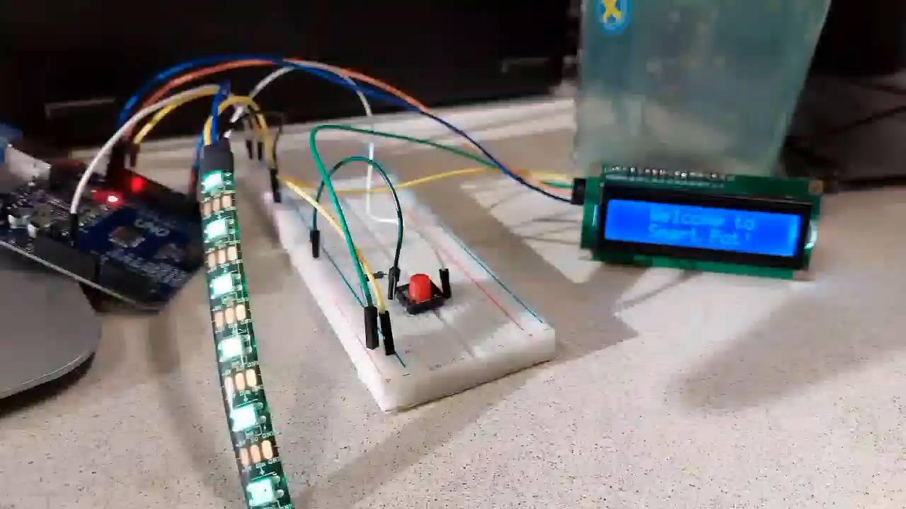
Part 1 – turn it on & off again

Slide 15
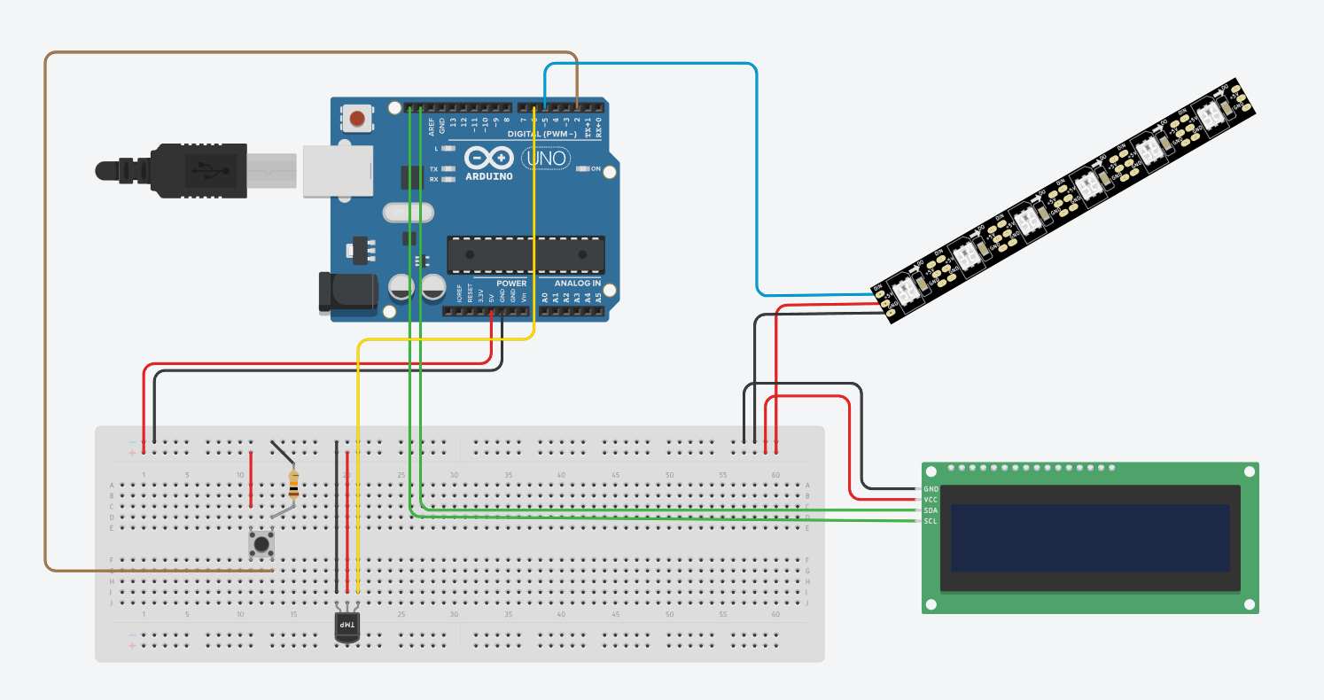
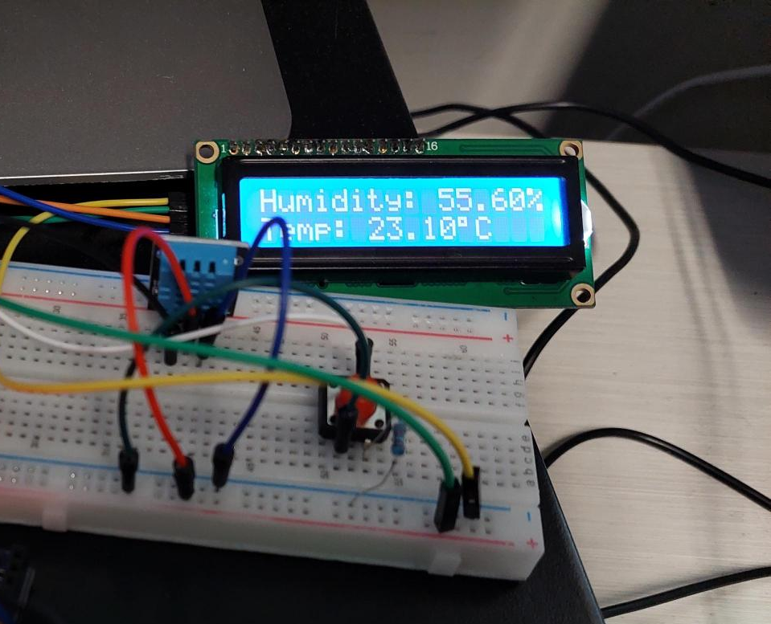
Part 2 – climate change

Slide 16
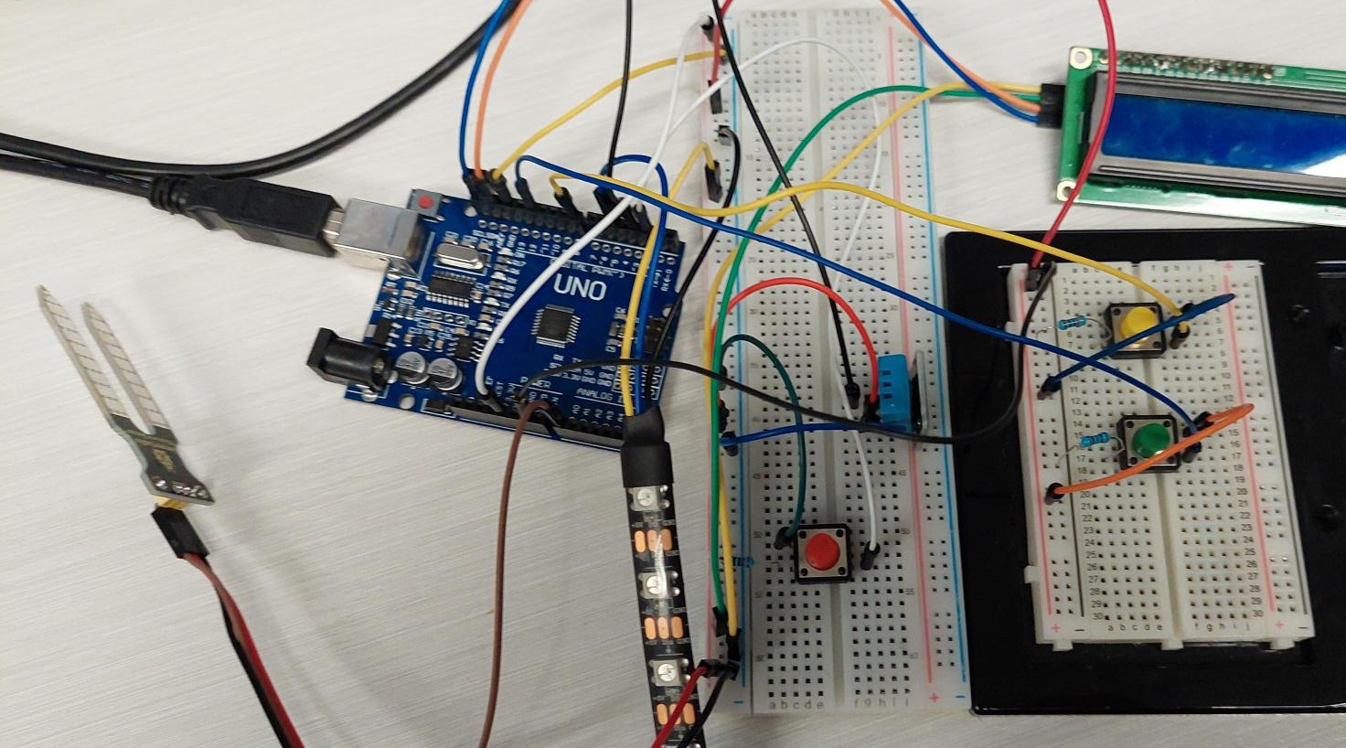
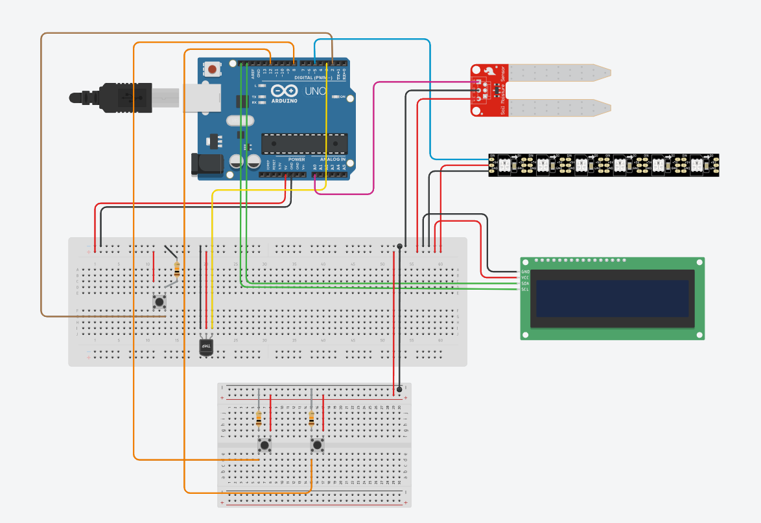
Part 3 – moist buttons

Slide 17
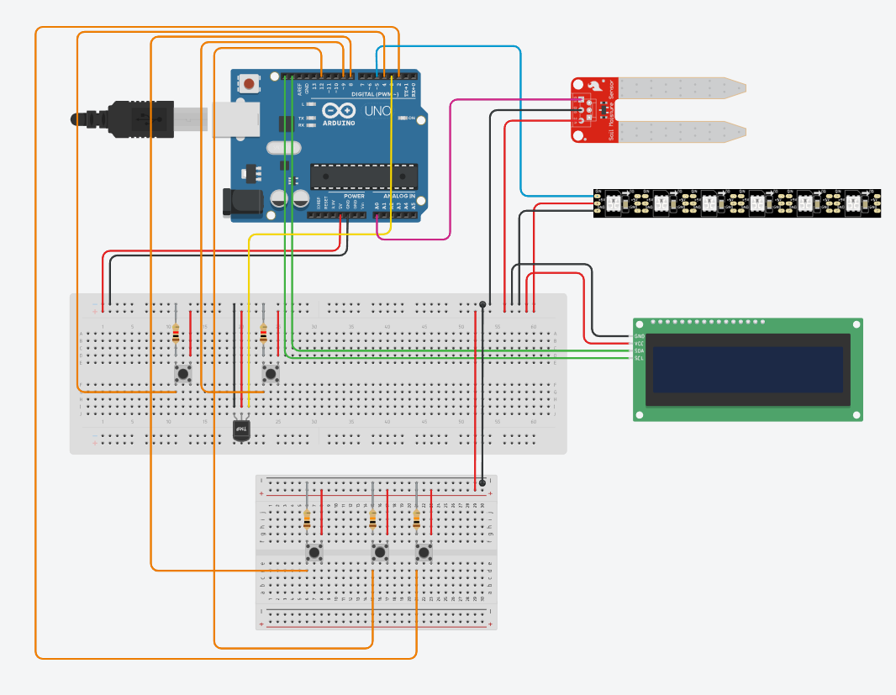
Part 4 can I get some buttons with that?

Slide 18
Actual implementation
Minimize scope
Track moisture and climate
Thresholds
Display info to screen
Buttons display different info/perform an action

Slide 19

Coding design
Turn an LED and LCD screen on/off using button
Display different messages
Chose to implement an FSM & watchdog
Buttons
Multiple outputs to screen
Error handling
Debugging
More features

Slide 20
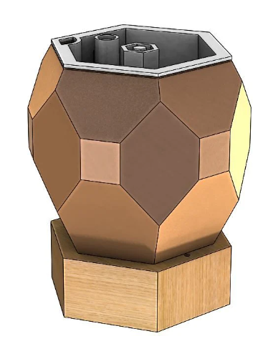
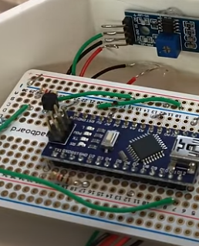
Hard choices…
For the wiring design, I was inspired by online resources
3D Printing ☹
Missing nano?!? Water pump didn’t arrive!!!!!
No water level sensor
No time to implement everything!
An app?? Sorry bud, no time for that

Slide 21
Soldering & box design
One must imagine Sisyphus happy

Slide 22
this is part of the reason I don’t have a working prototype right this moment…
I got kicked out of D block last night by security and my prototype got locked in the workshop

Slide 23
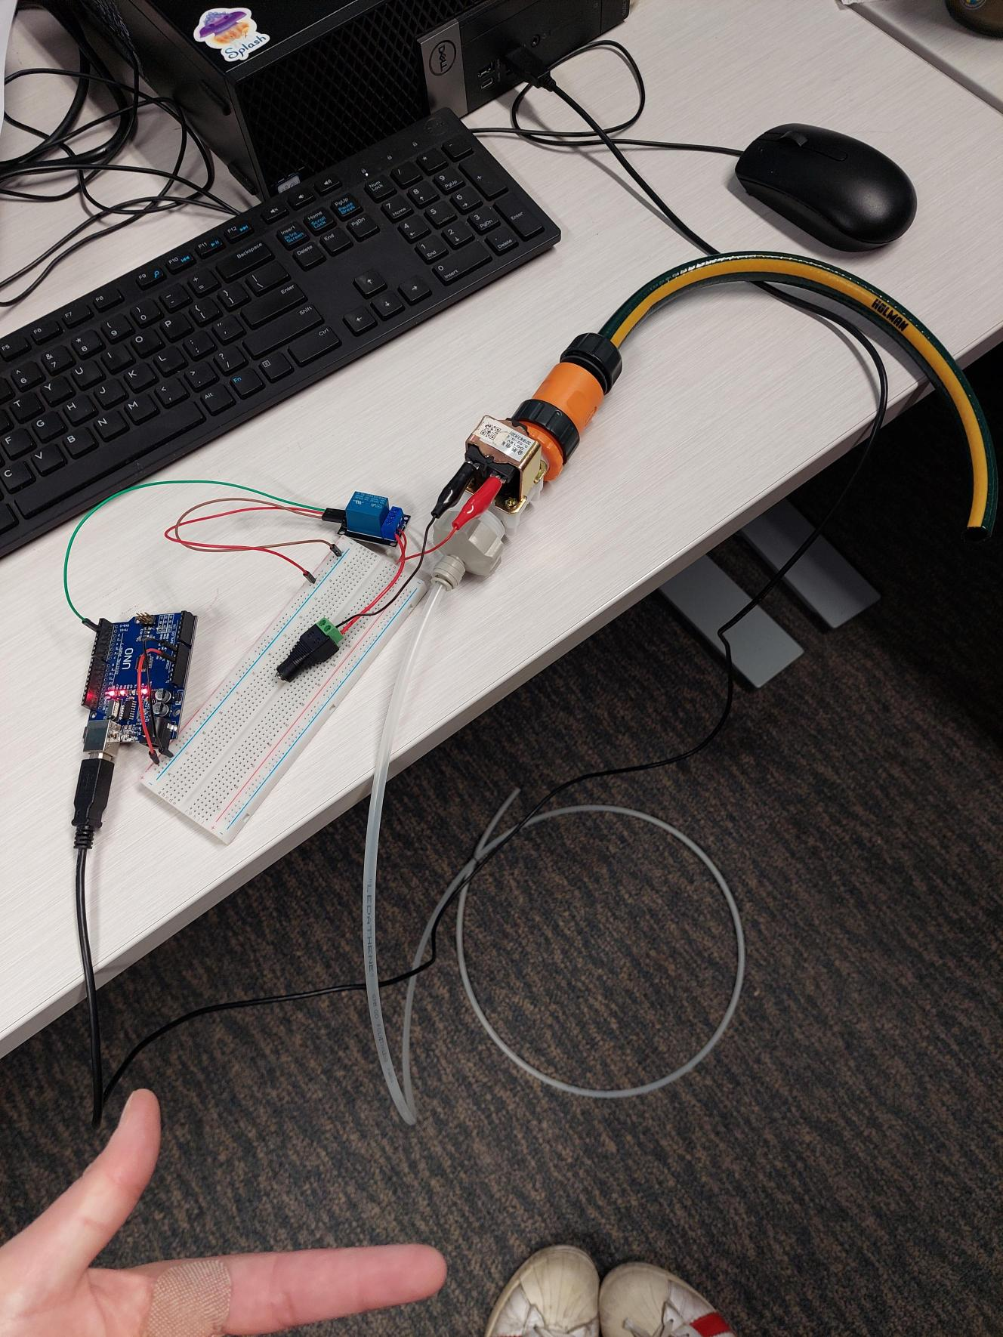
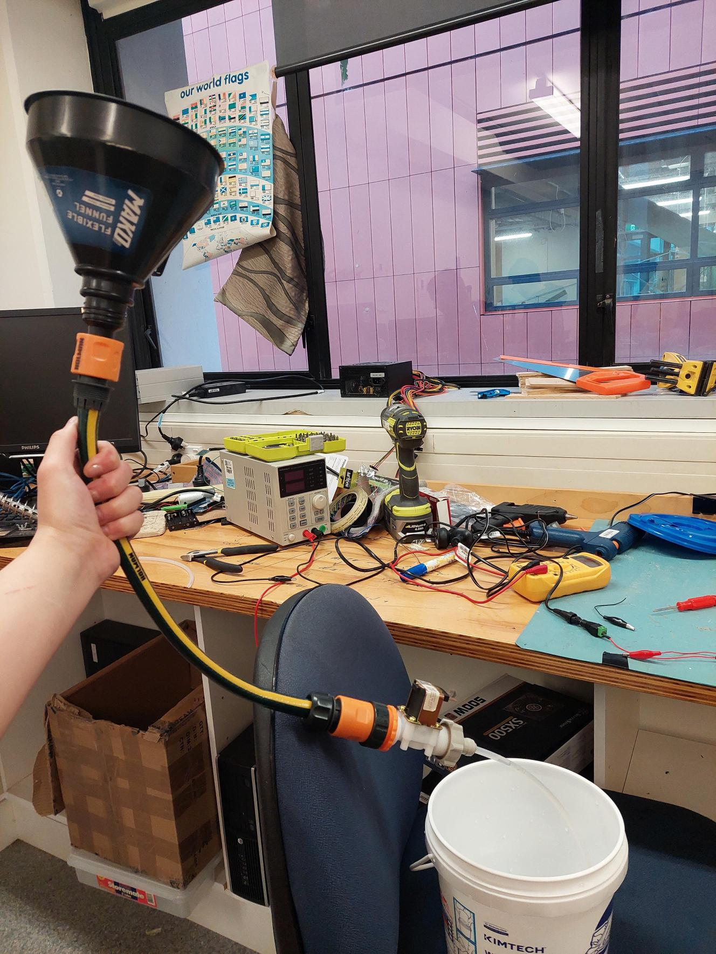
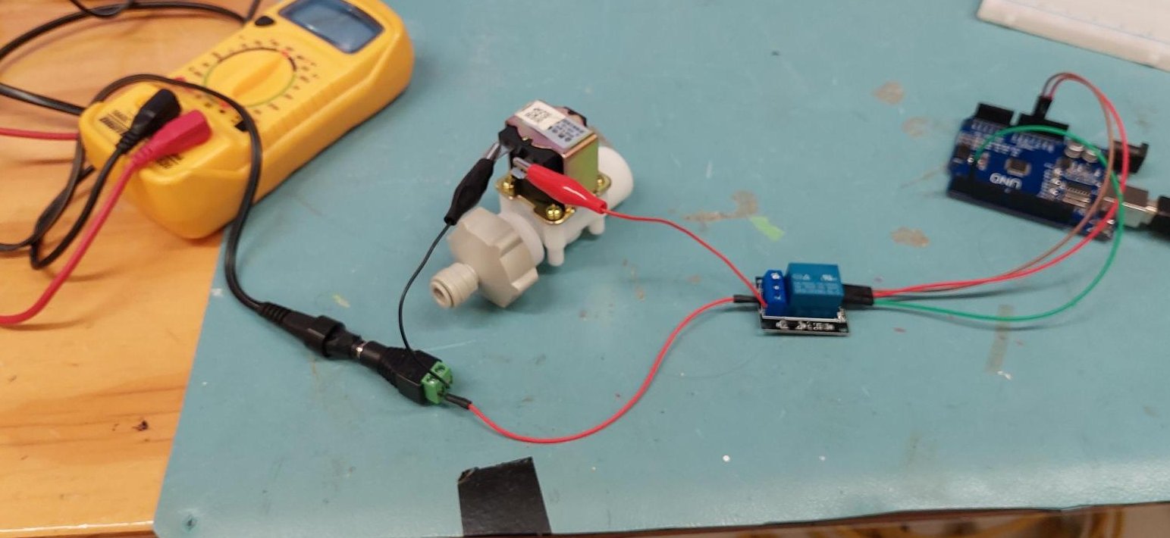

Slide 24
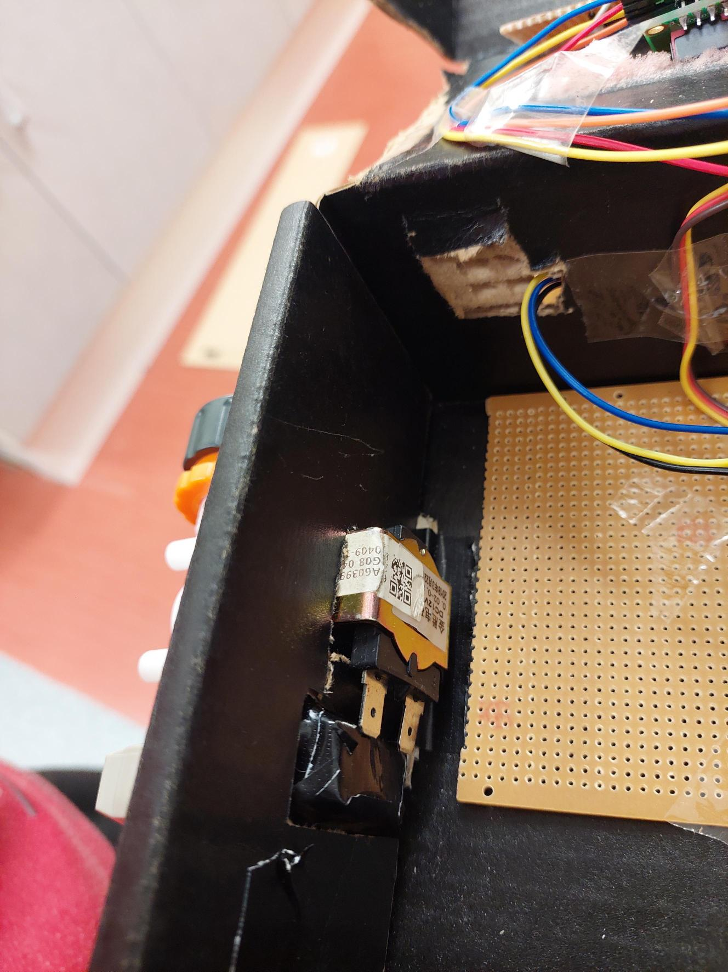
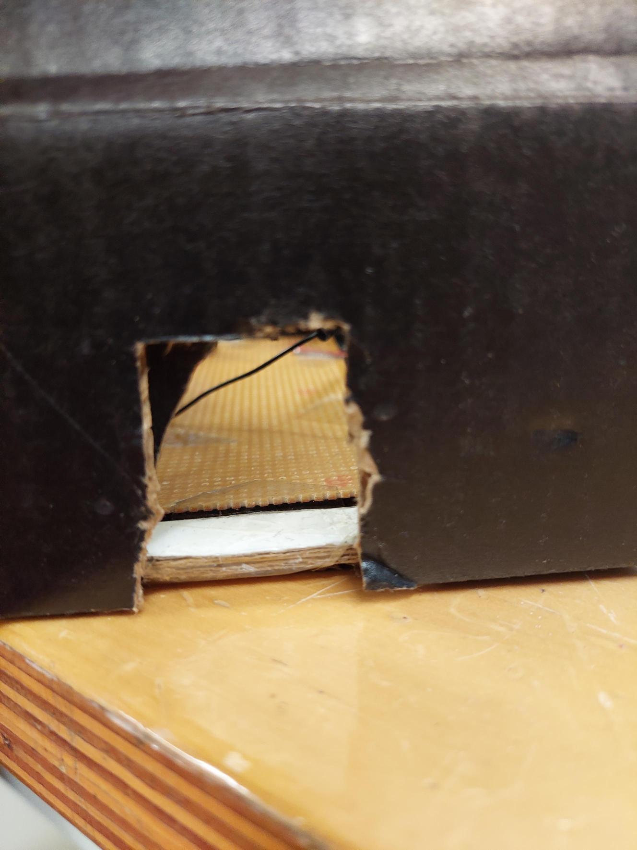
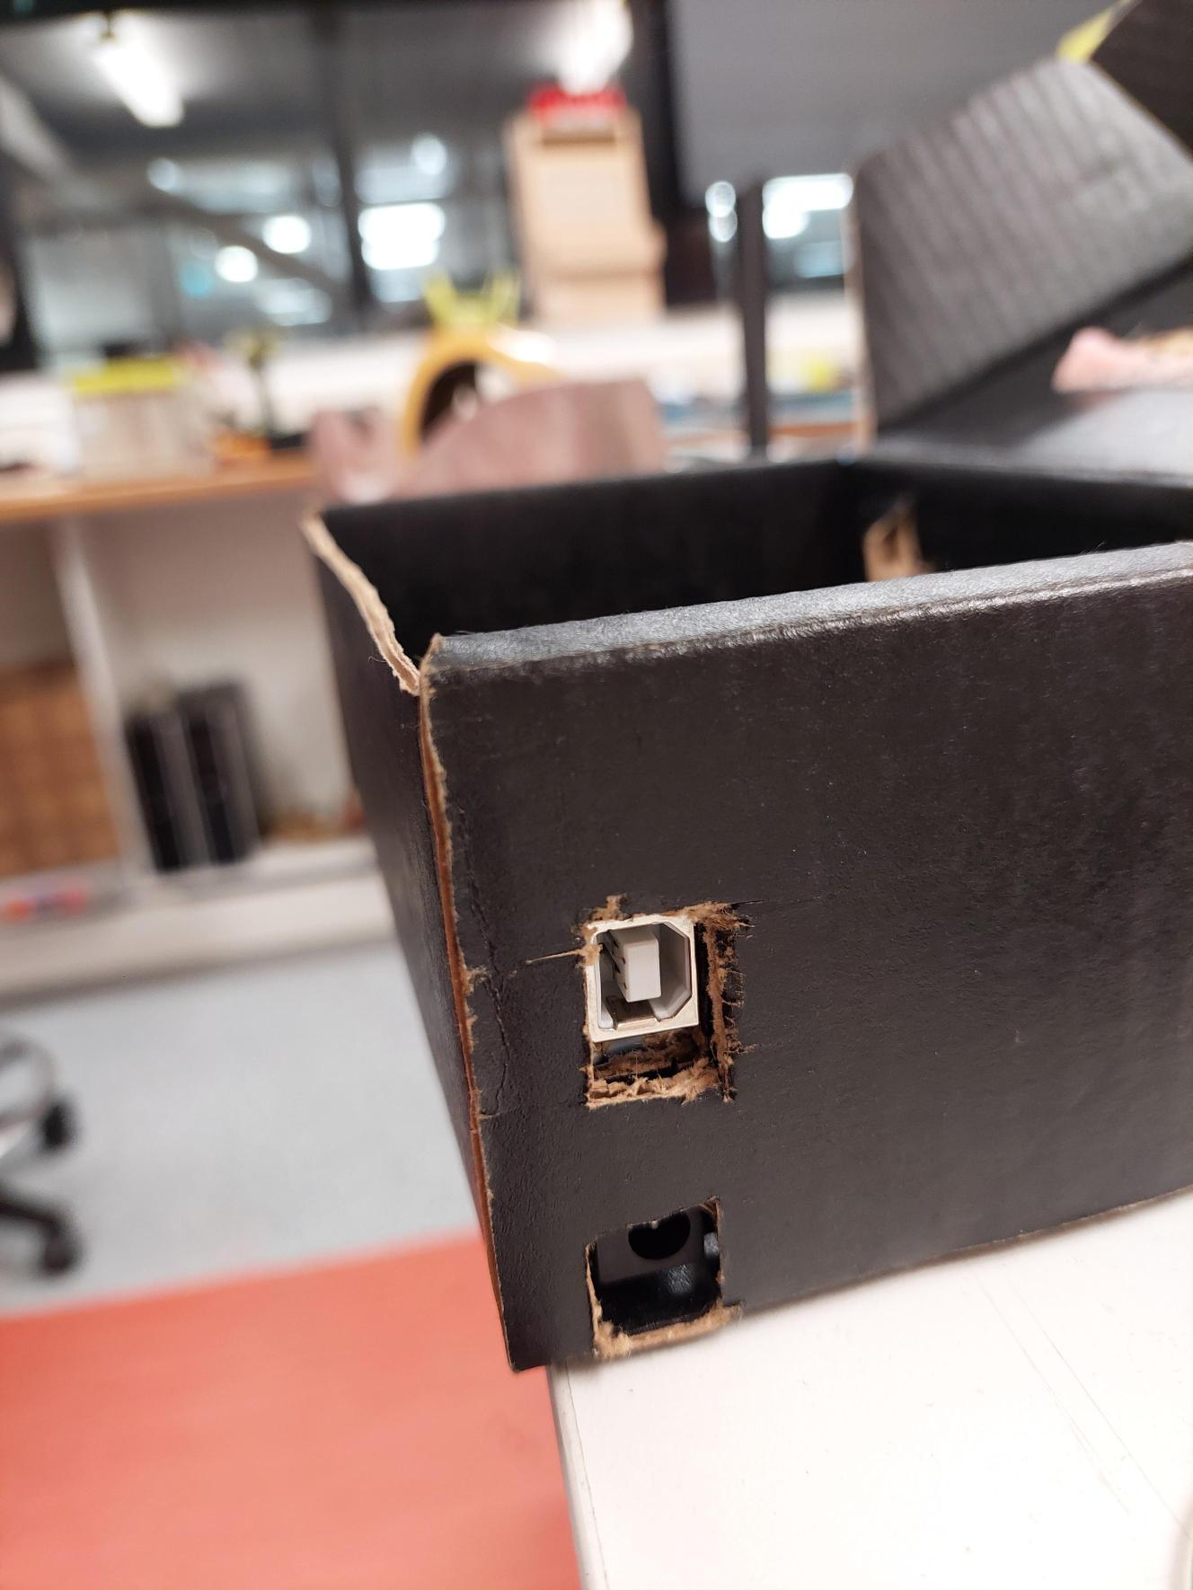
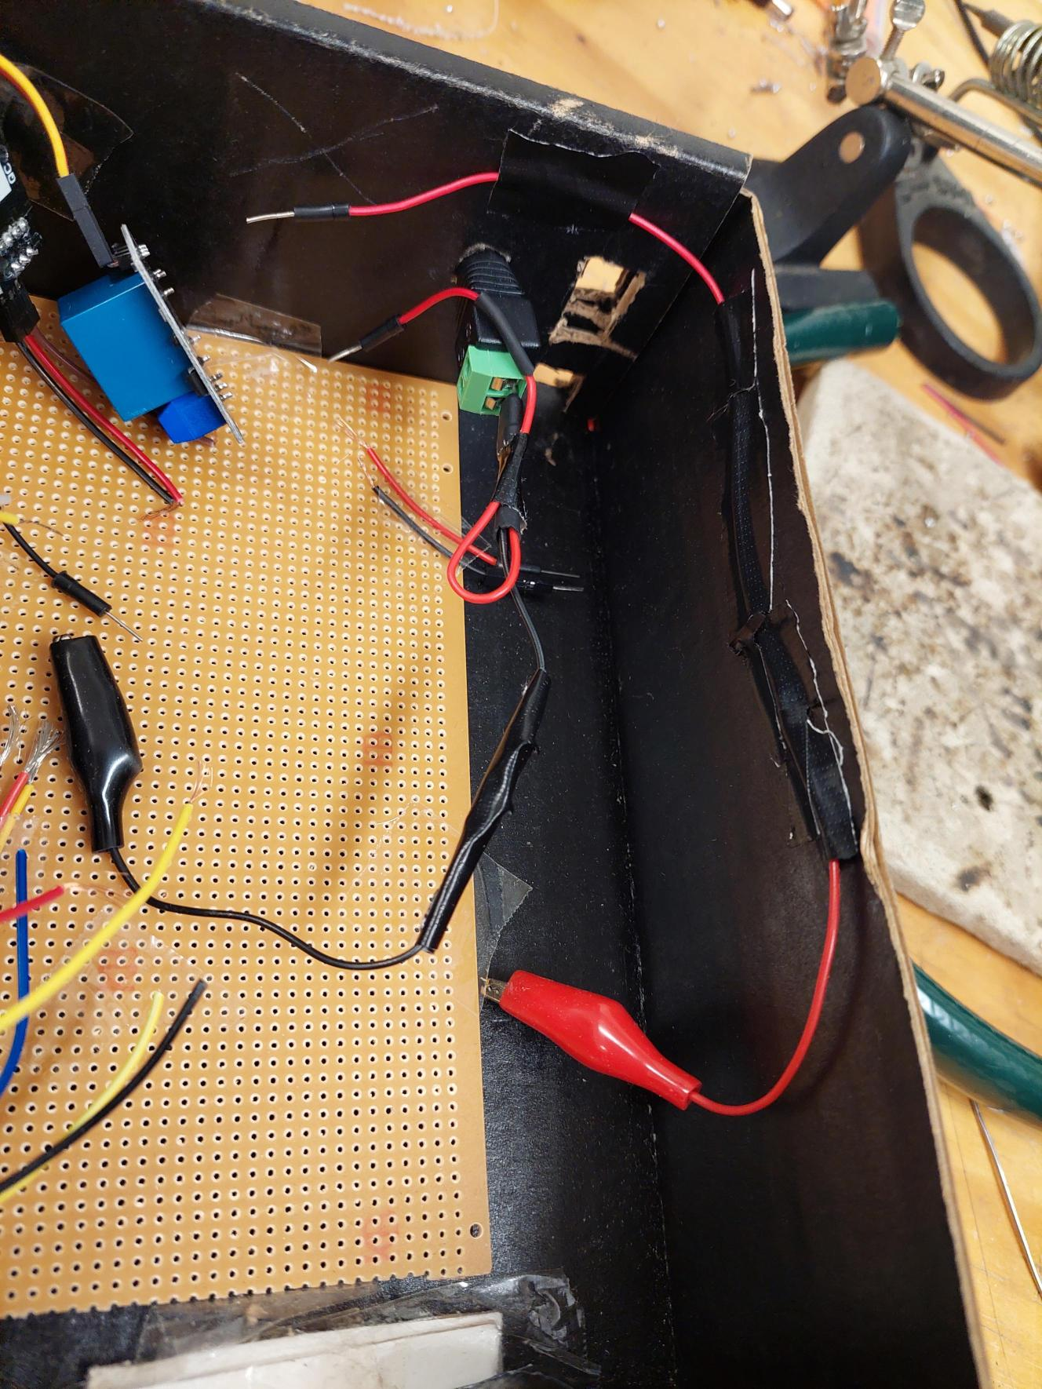

Slide 25
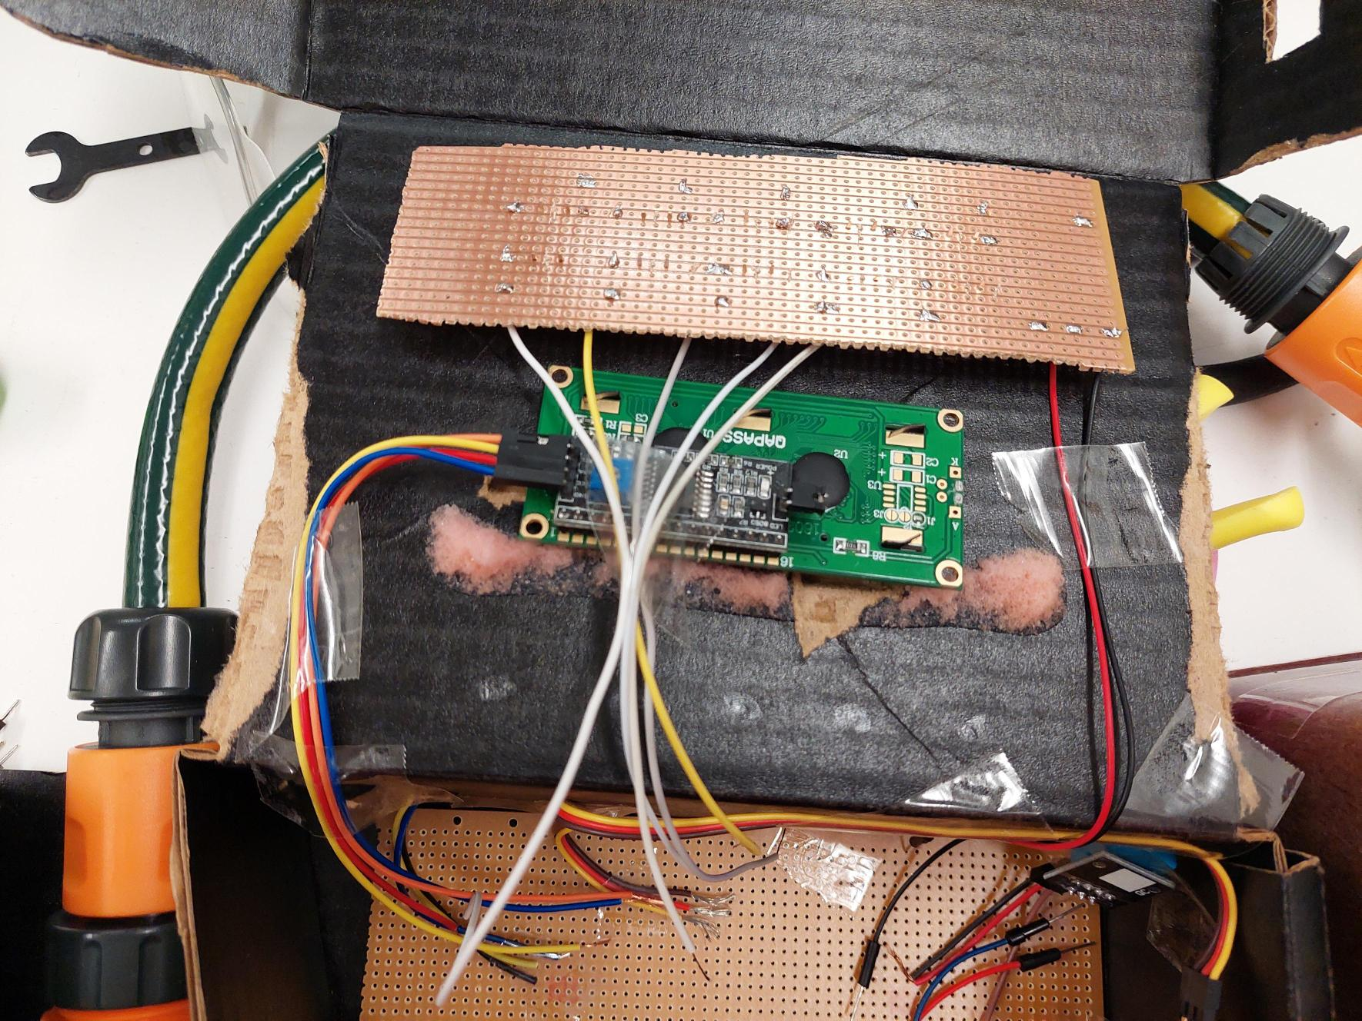
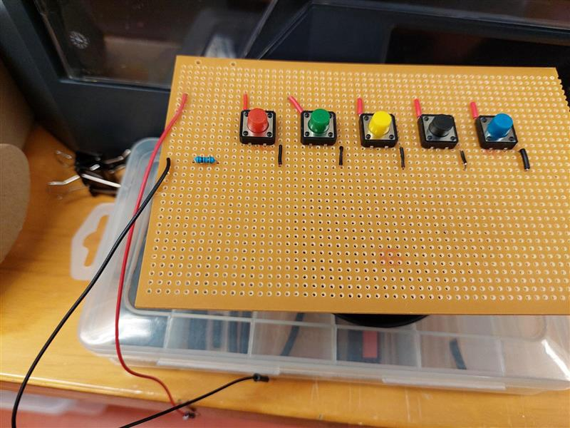
- I2C LCD screen yay!

Slide 26
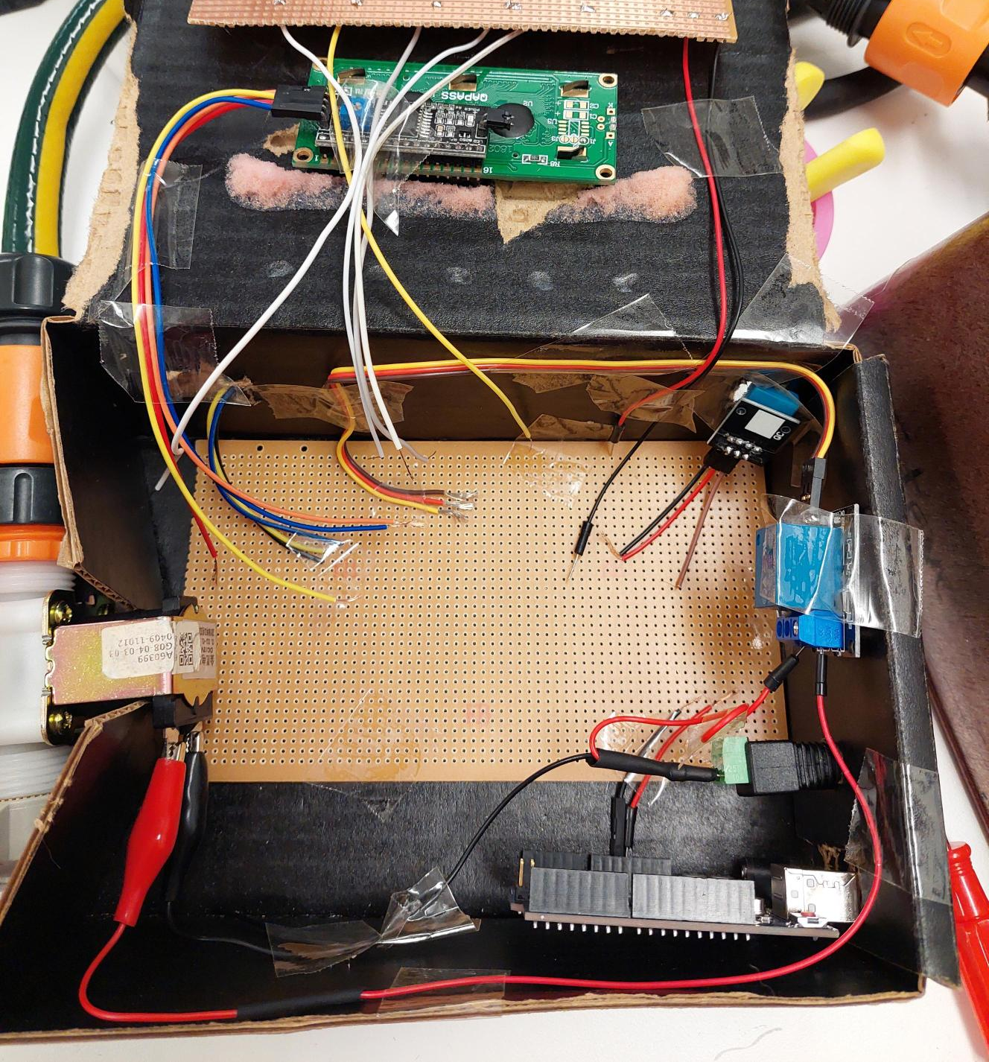

Slide 27
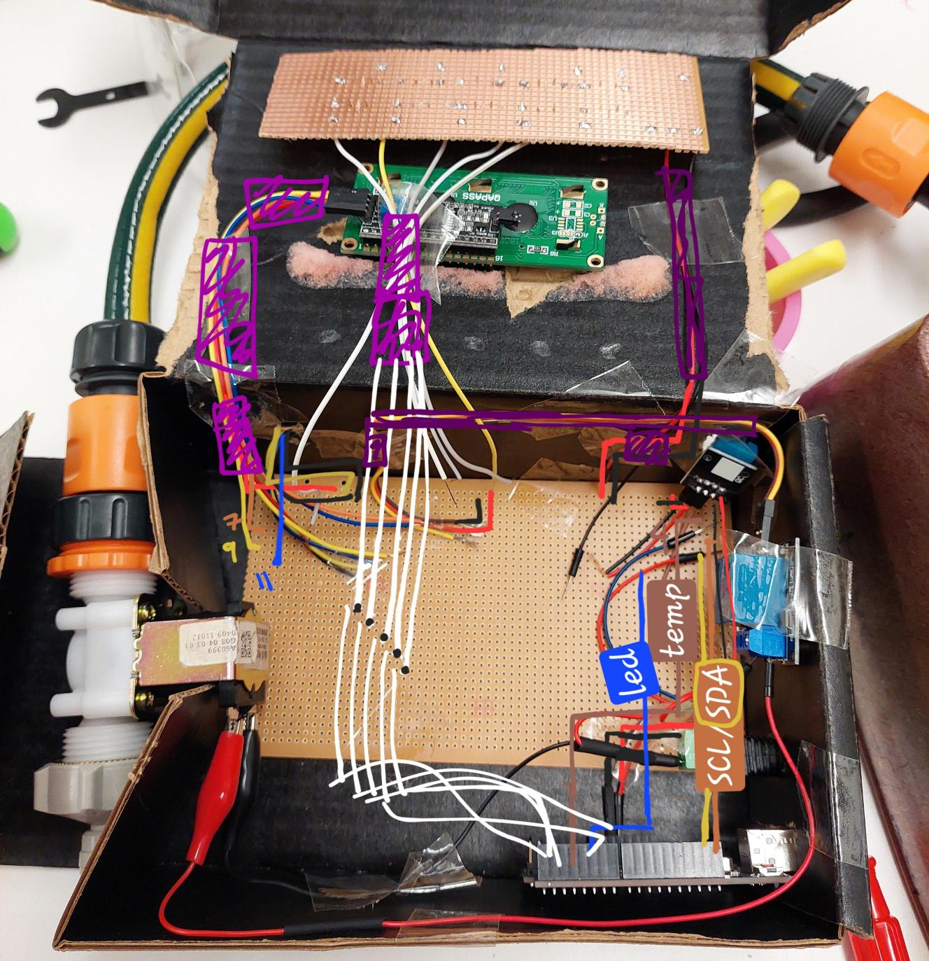

Slide 28
What happened?
The daily grind
Soldering wins and fails
Came to doing basic testing of the buttons circuit board…

Slide 29




To summarize…

Slide 30
Final Thoughts
The true final project is the friends we made along the way

Slide 31
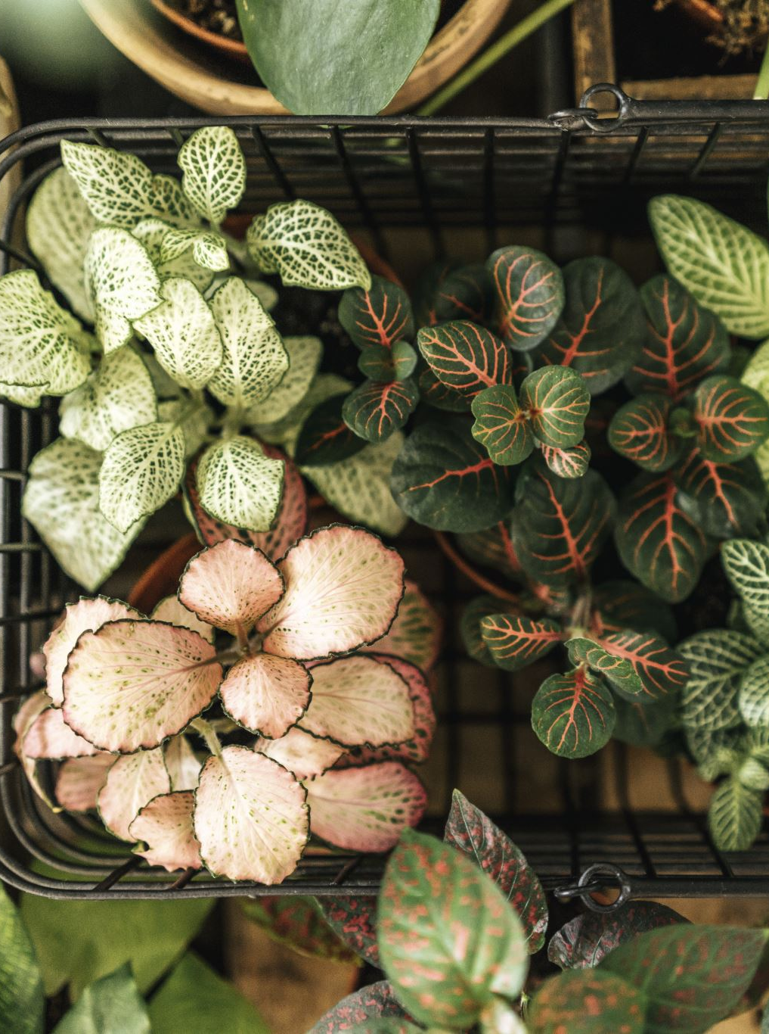
Full scope
Create an app with a web and mobile version
Users notified of plant status
Multiple plants
More sensors
Wi-Fi and Bluetooth capability
AI integration
App used by regular users and larger organizations for gardens

